Slide 1
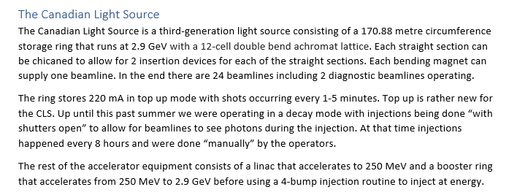
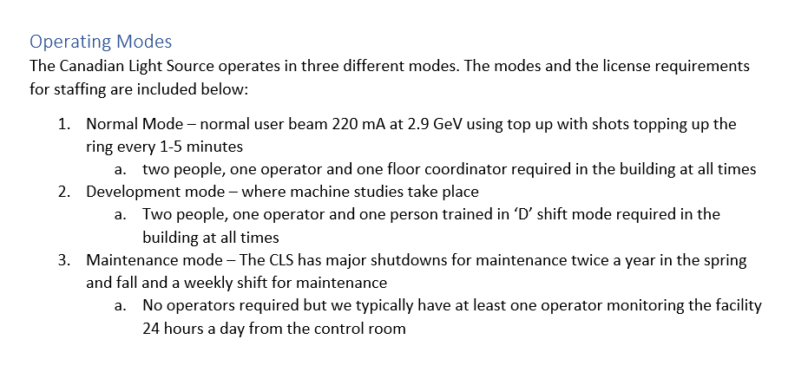
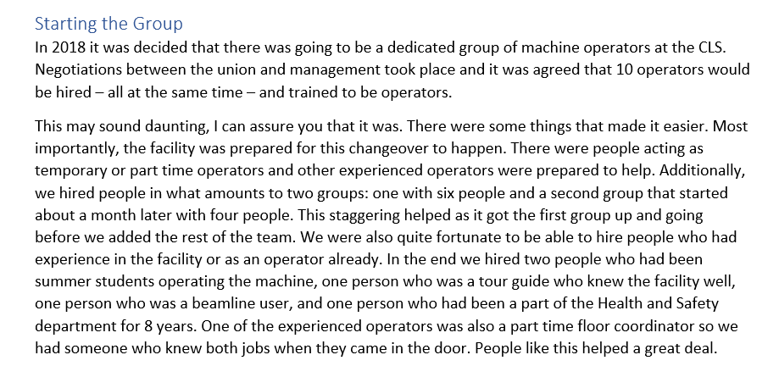
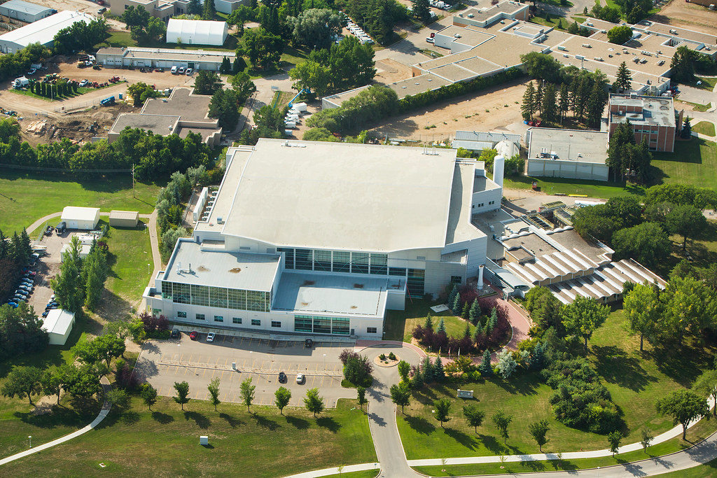
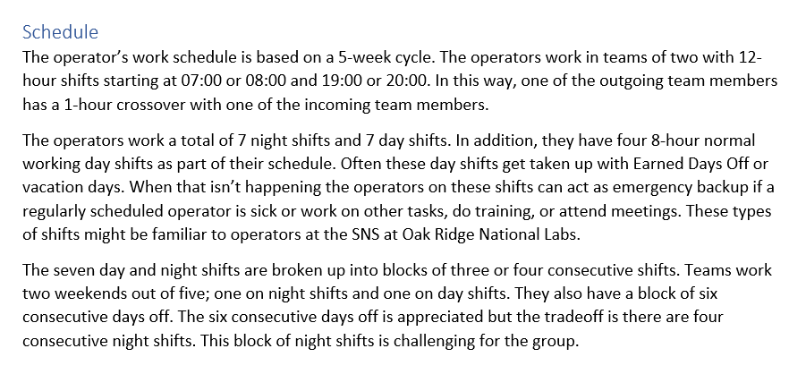
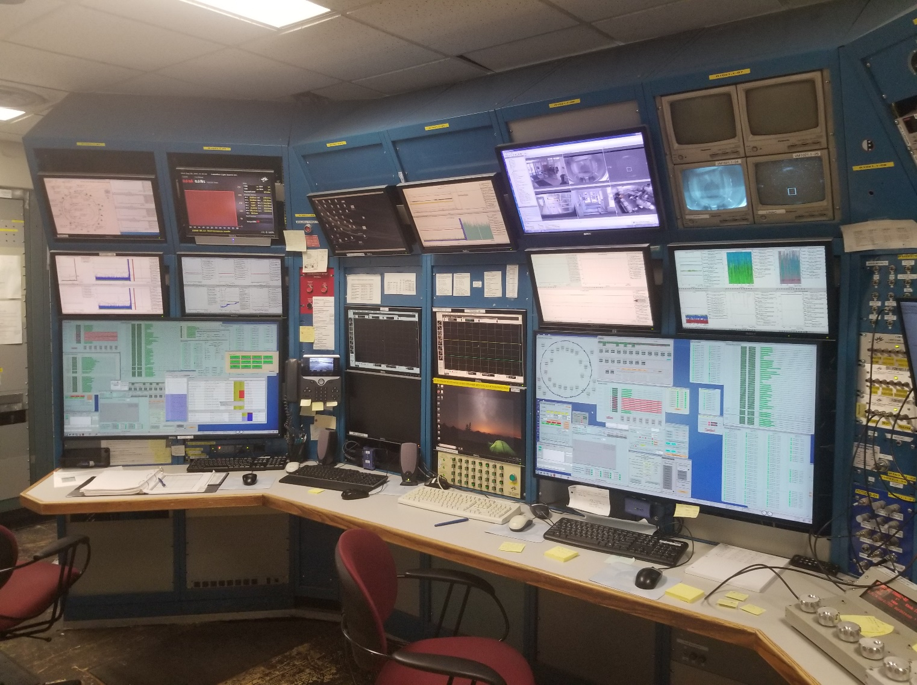
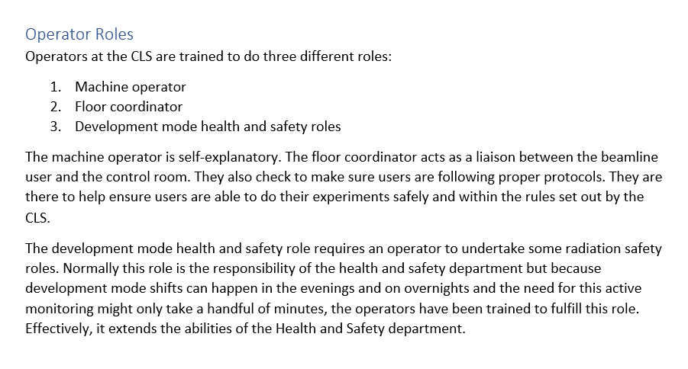
Creating the New Operator Group at the CLS
Grant Bilbrough, CLS Operator Lead
June 3, 2019 – six new operators and their supervisor start at the CLS
July 2, 2019 – two operators in the second group start work
July 9, 2019 – original 6 are qualified to operate the machine and act as floor coordinators independently
July 29, 2019 – third operator in second group starts
August 11, 2019 – fourth operator in the second group starts full time (had been working on a part time basis for a couple of weeks prior to this time)
September 1, 2019 08:00 – Operator shifts change from 8-hours long to 12-hours long. All operators are qualified to work as operators, floor coordinators, and Development Mode safety people by this time.
October 22, 2004 – CLS officially Opens
November 1964 – Saskatchewan Accelerator Lab, the precursor to the CLS, officially opens

